Slide 1


FILE CAMOUFLAGE
PROJECT ID: 23-PJ-IT-10
MENTOR: MS. JASNEET KAUR MA’AM
PROJECT MEMBERS
NIKHIL SAINI(1900300130064)
MD. SADIQUE RASHID(1900300130057) NAVEEN KUMAR VARSHNEY(1900300130063) ARUN KUMAR(1900300130018)
INDERPRASTHA ENGINEERING COLLEGE , GHAZIABAD, UTTAR PRADESH AFFILIATED TO DR. A.P.J. ABDUL KALAM TECHNICAL UNIVERSITY LUCKNOW, UTTAR PRADESH
(SESSION: 2022 - 2023)

Slide 2
INDEX
DESCRIPTION
OBJECTIVE
ABSTRACT
FLOW CHART
USE CASE DIAGRAM
HARDWARE REQUIREMENT
SOFTWARE REQUIREMENT
NAV BAR OF FILE CAMOUFLAGE
MAIN PAGE OF FILE CAMOUFLAGE
REFERENCES

Slide 3
DESCRIPTION
Steganography embeds a secret message inside an innocent looking cover medium, stealthily, without creating any attention. The cover medium used can be a text, image, audio, video, network packets, etc. In this desktop application there are 3 interfaces: Registration, Login, encode & decode. User needs to register first and he/she can login to the application while the user supposed to enter a PIN as a multifactor authentication when he/she login’s with username and password. After logging in, user can write text and encode it and can share with the person whom he/she wants to send the secret message. This is how the text steganography, hide text within text works.

Slide 4
OBJECTIVE
.
File Camouflage is a steganography technique implemented, to hide secrets inside text by encrypting the secret before cloaking it with special unicode invisible characters. It can be used to safely watermark strings, invisible scripts on webpages, texts on social media or for any other covert communication. Completely invisible!

Slide 5
ABSTRACT
The word steganography means” covered in hidden writing”. The object of steganography is to send a message through some innocuous carrier (to a receiver while preventing anyone else from knowing that a message is being sent to all. Computer based steganography allows changes to be made to what are known as digital carriers such as images or sounds.

Slide 6
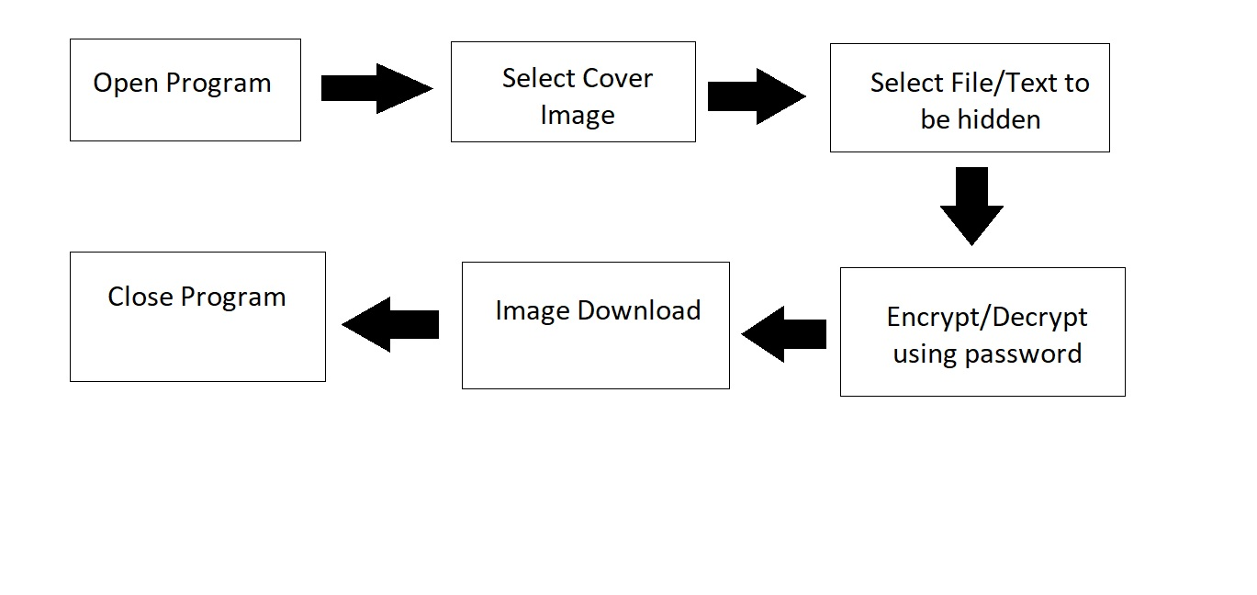
FLOW CHART

Slide 7



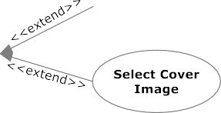



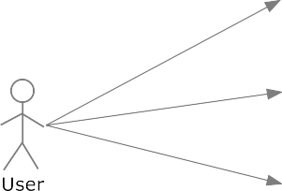






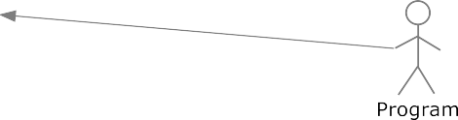


USE CASE DIAGRAM

Slide 8
HARDWARE REQUIREMENTS
Processor - Dual Core/ Pentium/ i3 Intel Processor
RAM - 2 GB
Hard Disk - 512MB
Keyboard - Standard Windows Keyboard
Mouse - Two or Three Button Mouse
Monitor - Any

Slide 9
SOFTWARE REQUIREMENTS
Operating System - Windows XP/7/8/10/11
Server-side Script - JavaScript

Slide 10
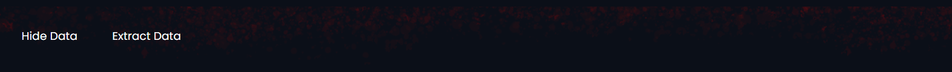
NAV BAR OF FILE CAMOUFLAGE
The Nav Bar contains two links :
Hide Data: to hide a file inside an image.
Extract Data: to retrieve data hidden in an image file.

Slide 11

MAIN PAGE OF FILE CAMOUFLAGE
In the main page we first have to select an image and then we have to choose weather we want to hide a text or a file. After that we have to enter a password and click on hide button and the data will be hidden.

Slide 12
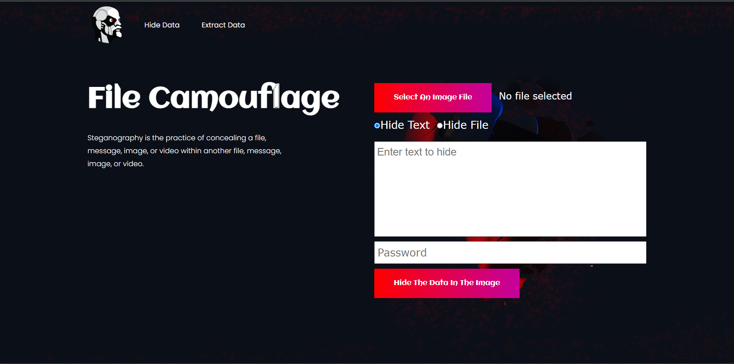

Slide 13

REFERENCES
https://www.w3schools.com
https://developer.mozilla.org
https://www.javapoint.com
https://www.youtube.com
https://www.wikipedia.com

Slide 14
REFERENCES
Rosziati Ibrahim and Teoh Suk Kuan, Steganography Imaging System (SIS): Hiding Secret Message inside an Image http://www.iaeng.org/publication/WCECS2010/WCECS2010_pp144-148.pdf
Zaidoon Kh. AL-Ani, A.A.Zaidan, B.B.Zaidan and Hamdan.O.Alanazi, Overview: Main Fundamentals for Steganography
http://arxiv.org/ftp/arxiv/papers/1003/1003.4086.pdf
Bere Sachin Sukhadeo, User Aware Image Tag Refinement http://www.ijcsmr.org/eetecme2013/paper19.pdf

